Slide 1
Final Project Machine Learning
Name: Nadukula Akanksha

Slide 2
Content:
Problem Statement
Data Description
Analysis
Conclusion And Discussion
Summary

Slide 3
Problem Statement:
Analyzing the fuel consumption based on their wastage emission.

Slide 4
Data Description:
The following actions are conducted in order to address the problem based on data :
Examining the data.
Omitted the missing values in the data.
Given data is Sampled based on 2% of the over all data.
Partition of 75% of sampled data.
Normalized the data.

Slide 5
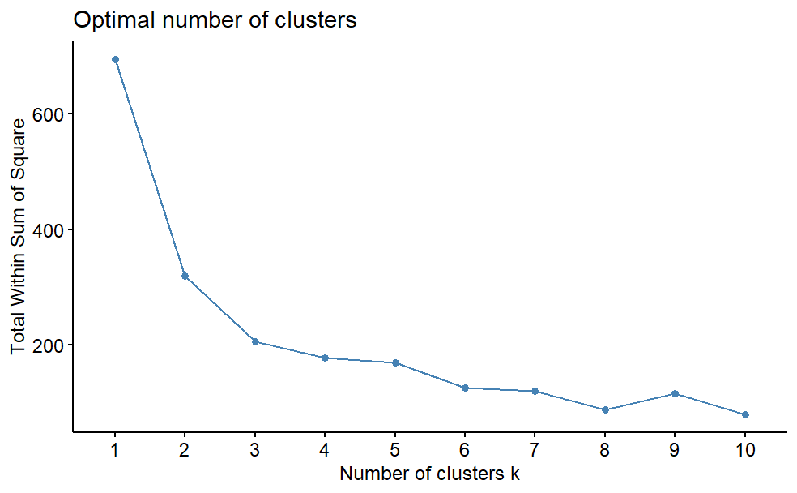
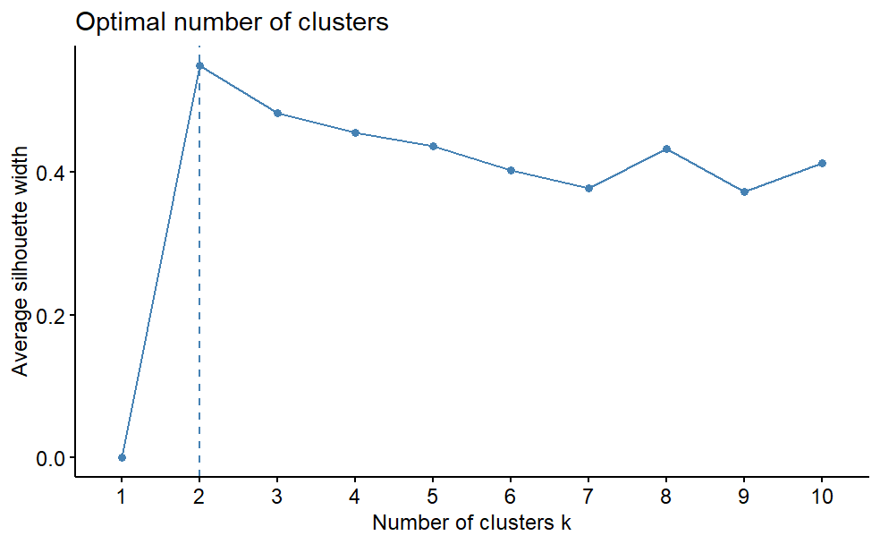
Analysis
By using the Kmeans performed graphs with two methods Wss and Silhouette results are 3, 2 centers respectively.
With using of the centers performing the kmeans

Slide 6
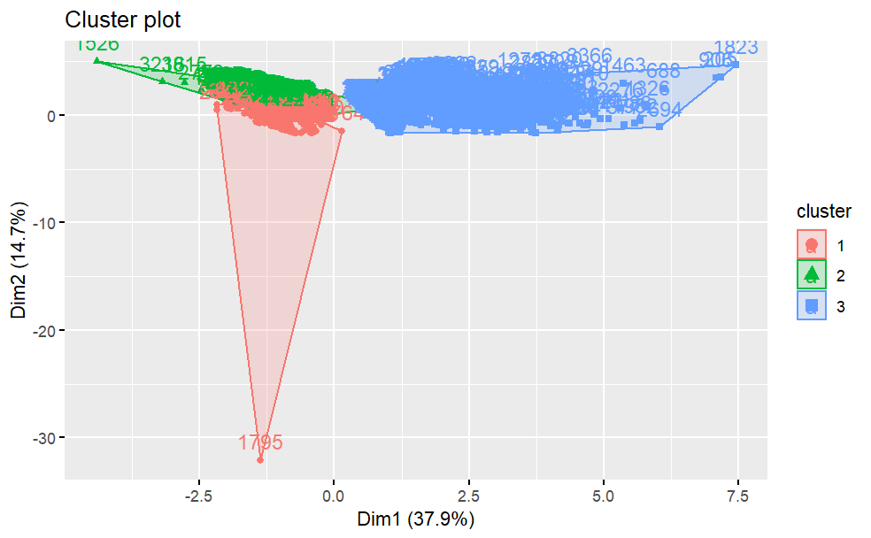
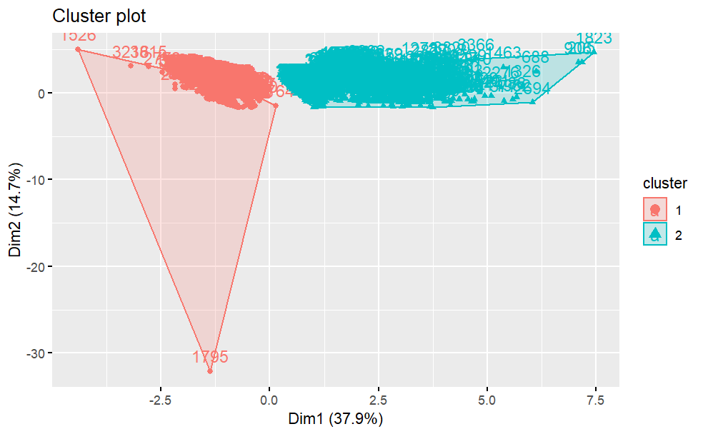
Analysis:
We can observe from 2 clusters have no overlaps on them when compared to 3 cluster division.
Hence we selected with 2 clusters

Slide 7
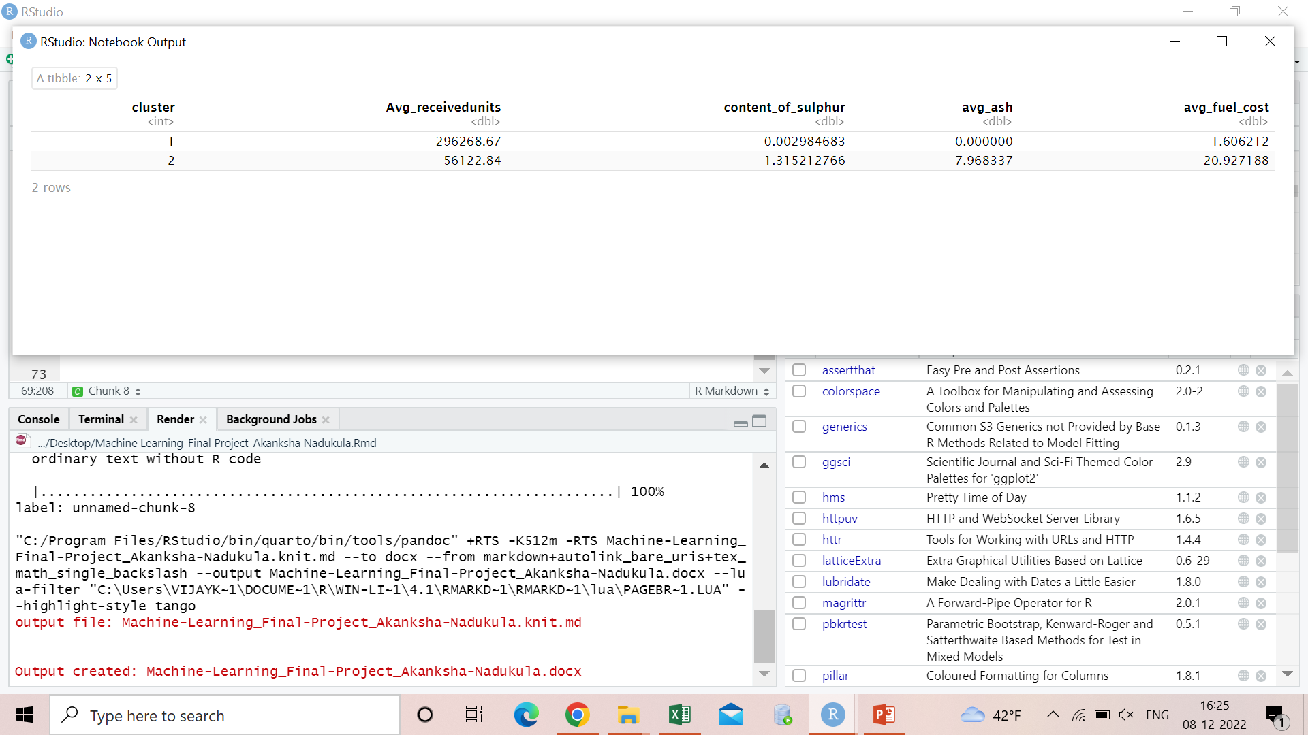
Cluster 1: high fuel usage when it is more ecologically good Cluster 2: low fuel usage when there is increase in ash and sulfur emission.

Slide 8
Conclusion :
We can observe from the clusters is that when ever there is high emission of sulfur and ash contents, people are tending those fuels less and switching to fuels that are more environmentally efficient.
We can observe the same from cluster 1

Slide 9
THANK YOU

